Slide 1
St Ann Catholic Church (Johnston county)
2023 Facilities Planning

Slide 2
Registered Family Growth
6,000 (2030)
3,600 (2022)
Projected
500 (2000)
1,100 (2015)
5,000 (2026)

Slide 3
2023 Facilities Planning
What facilities are needed to accommodate this growth?

Slide 4
Current Conditions:
8 masses every weekend – keeps our Priests hopping!
Ash Wednesday masses were overflowing!
Parking and traffic between Sunday morning masses have become jammed.

Slide 5
2023 Facilities Planning
Current Conditions:
It is often hard to find available rooms for ministry meetings in the Learning Center.
The Social Hall is often overflowing for events.

Slide 6
2023 Facilities Planning
Imagine what our campus will be like when we have twice as many people?

Slide 7
New / Expanded Facilities Needed
Land
Parking
Larger Church
Day Chapel
Larger Classroom Bldg
Larger Social Hall
Office Space
Playground
Outdoor Recreation
St Ann Pre-K Program
St Ann Private K-12 School
Opport for Rosary Walk

Slide 8
Aerial Photo 2023

Slide 9
15 Acres
(Currently Owned)
St Ann Land (Current)

Slide 10
16 Acres
Adjacent Land Parcel Possibilities
15 Acres
(Currently Owned)
1.5 Acres
65 Acres

Slide 11
Addit. Parking Possibilities
Surface Parking
Surface Parking
Potential Parking Structure
Surface Parking

Slide 12
2020 MASTERPLAN
Storage Building

Slide 13
St Ann Catholic Church (Johnston County)
2023 Aerial Photo

Slide 14
St Ann Catholic Church (Johnston County)
Existing Learning Centers
Existing Parish Center
2023 Aerial Photo
Existing Church

Slide 15
St Ann Catholic Church (Johnston County)
Expanded Church and Narthex

Slide 16
St Ann Catholic Church (Johnston County)
Day Chapel

Slide 17
St Ann Catholic Church (Johnston County)
Consolidated Office Space

Slide 18
St Ann Catholic Church (Johnston County)
Permanent Learning Center and Social Hall

Slide 19
St Ann Catholic Church (Johnston County)
Learning Center
Day Chapel
Social Hall
Offices
2020 Masterplan
Narthex
Expanded Church Transepts

Slide 20
St Ann Catholic Church – Masterplan

Slide 21
St Ann Catholic Church – Expansion Concept

Slide 22
St Ann Catholic Church – Expansion Concept
Expanded Transept
Existing Nave, Narthex, Sacresty and Restrooms
Expanded Transept
Expanded Narthex
Existing Seating : 600
Additional Seating: 629

Slide 23
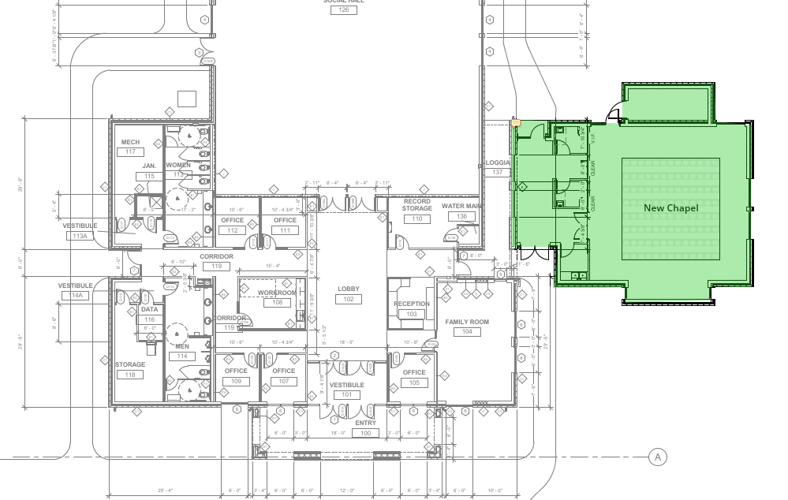
St Ann Catholic Church – Day Chapel Concept
New Day Chapel
Existing Parish Center Offices and Lobby

Slide 24
St Ann Catholic Church – Office Concept
New Office Wing
New Day Chapel
Existing Parish Center Offices and Lobby

Slide 25
St Ann Catholic Church – Masterplan

Slide 26
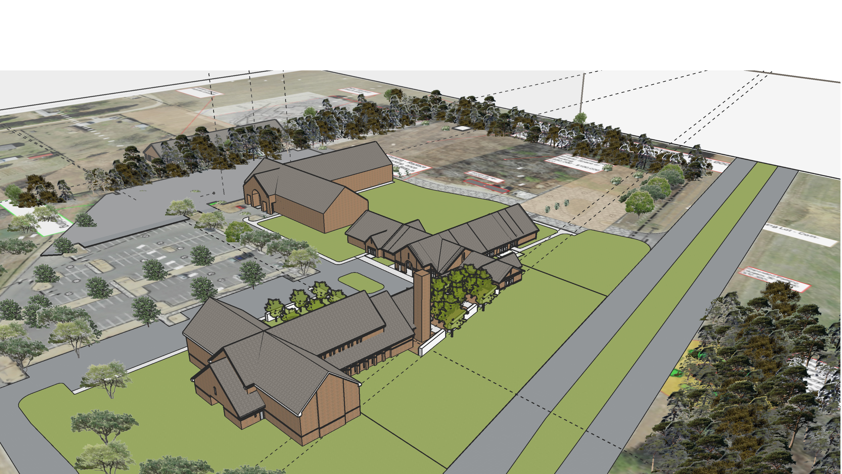
2020 Masterplan

Slide 27
St Ann Catholic Church
Parish Survey – Facilities
May and June, 2023

Slide 28
St Ann Catholic Church Building Facility Survey
St Ann Church is growing at a rapid pace.
There are currently no plans for a 2nd church within the Raleigh Diocese to serve Johnson County.
As such, it is time to expand our facilities.
A survey of parishioners was conducted to solicit feedback on priorities for new or expanded facilities.
To Date, we have received over 800 responses to the survey.

Slide 29
St Ann Catholic Church Building Facility Survey
The Bishop has blessed our plans to launch a campaign to expand our facilities
We are initiating a financial campaign now!
Pledges will be sought with the opportunity to contribute over a 4 to 5-year timeframe.
Please pray for our parish, and for our ability to answer God’s call with the success of this campaign.

Slide 30
St Ann Catholic Church Building Facility Survey
Prominent Feedback from the survey includes:
Overwhelming support for expanding facilities. 90% of respondents indicate a willingness to contribute financially.
Top Facility needs are
Expanding the Church
Expanding Parking
Purchasing adjacent land when it becomes available.

Slide 32
St Ann Catholic Church Building Facility Survey
Additional Feedback from the survey includes:
Strong support for
A new Learning Center,
Larger Social Hall, and
A Day Chapel

Slide 33
Response Demographics

Slide 34
Willingness to Support Financially

